Slide 1
Public Engagement Risk
Public Engagement Workshop
Kris Riesenberg
Technical Services Team Leader

Slide 2
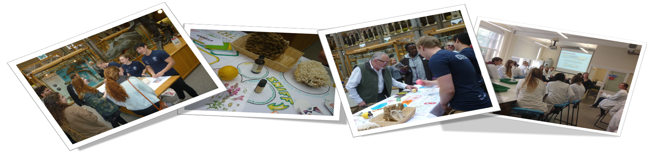
Public Engagement Risk
What is the public engagement risk?
How are the MnDOT/FHWA risks developed?
Why is the risk important?
What is the expected outcome?
What are the next steps?

Slide 3
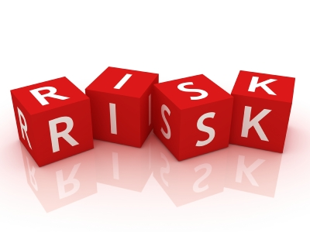
Public Engagement Risk
If customer engagement during scoping is improved, then the customer needs can be understood to help design projects and build public trust.

Slide 4
Risk Process
Develop Objectives
Assess performance to achieving Objectives
Determine Risks
Prioritize Risks
Develop Response Strategy We are here
Implement & Monitor Effectiveness

Slide 5
MN & National
Importance
MnDOT’s WIG – Customer Trust
Performance Based Practical Design – Identify user needs for design consideration
Complete Streets – Identify user needs for modal inclusion considerations
Title 6 – Identify user needs & impacts for enhancement, avoidance, minimization & mitigation

Slide 6
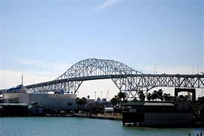
TXDOT bridge project stopped
Civil rights complaint over Harbor Bridge replacement project
Complaint stops the project
US 181 Harbor Bridge Replacement in TX - https://www.txdot.gov/inside-txdot/projects/studies/corpus-christi/harbor-bridge.html
Civil rights complaint over Harbor Bridge replacement project- http://www.kristv.com/story/28768769/civil-rights-complaint-over-harbor-bridge-replacement-project

Slide 7

Risk Outcomes
Improved Customer Trust
Enhanced processes for:
Identification of affected communities
Outreach to understand what is important to affected communities
Characterizing the impacts
Developing appropriate enhancement, avoidance, minimization, or mitigation measures

Slide 8

Risk Next Steps
Develop Risk Response Strategies
What specific activities can we do?
Implement Response Strategies
Who’s going to do it & by when?
Monitor Effectiveness
How do we track success & refine strategies?

Slide 9

Conclusion
Thank you!

